Slide 1
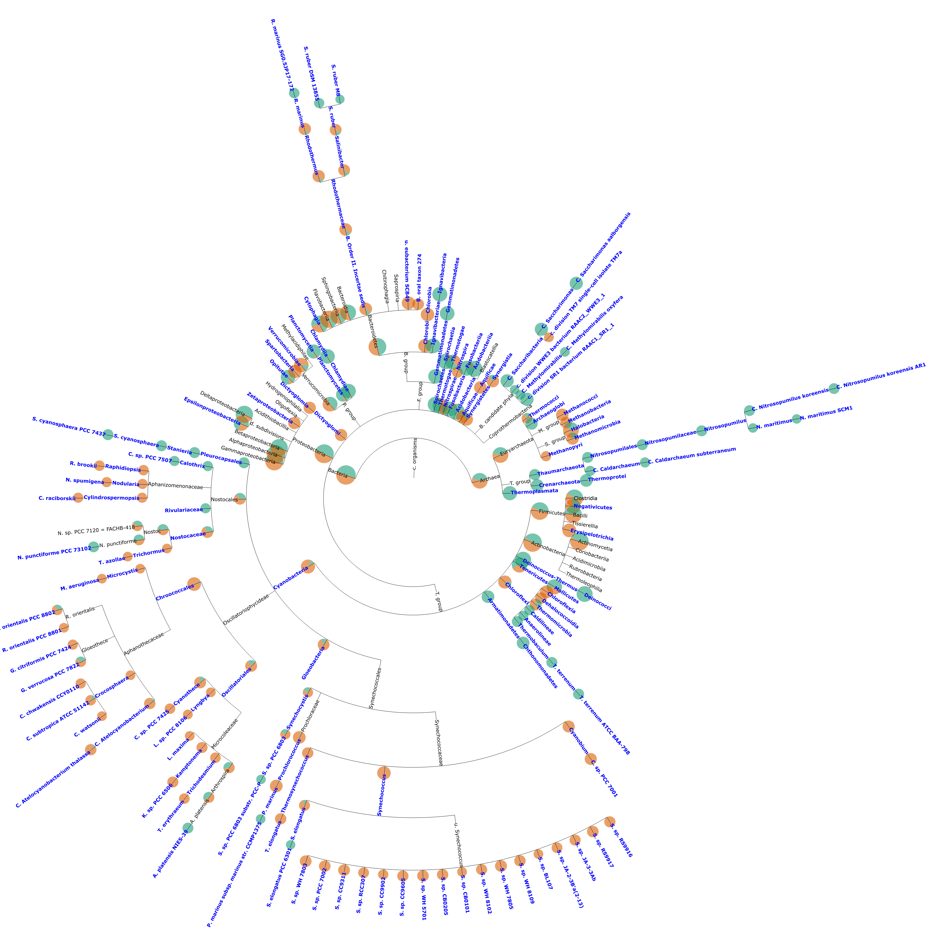
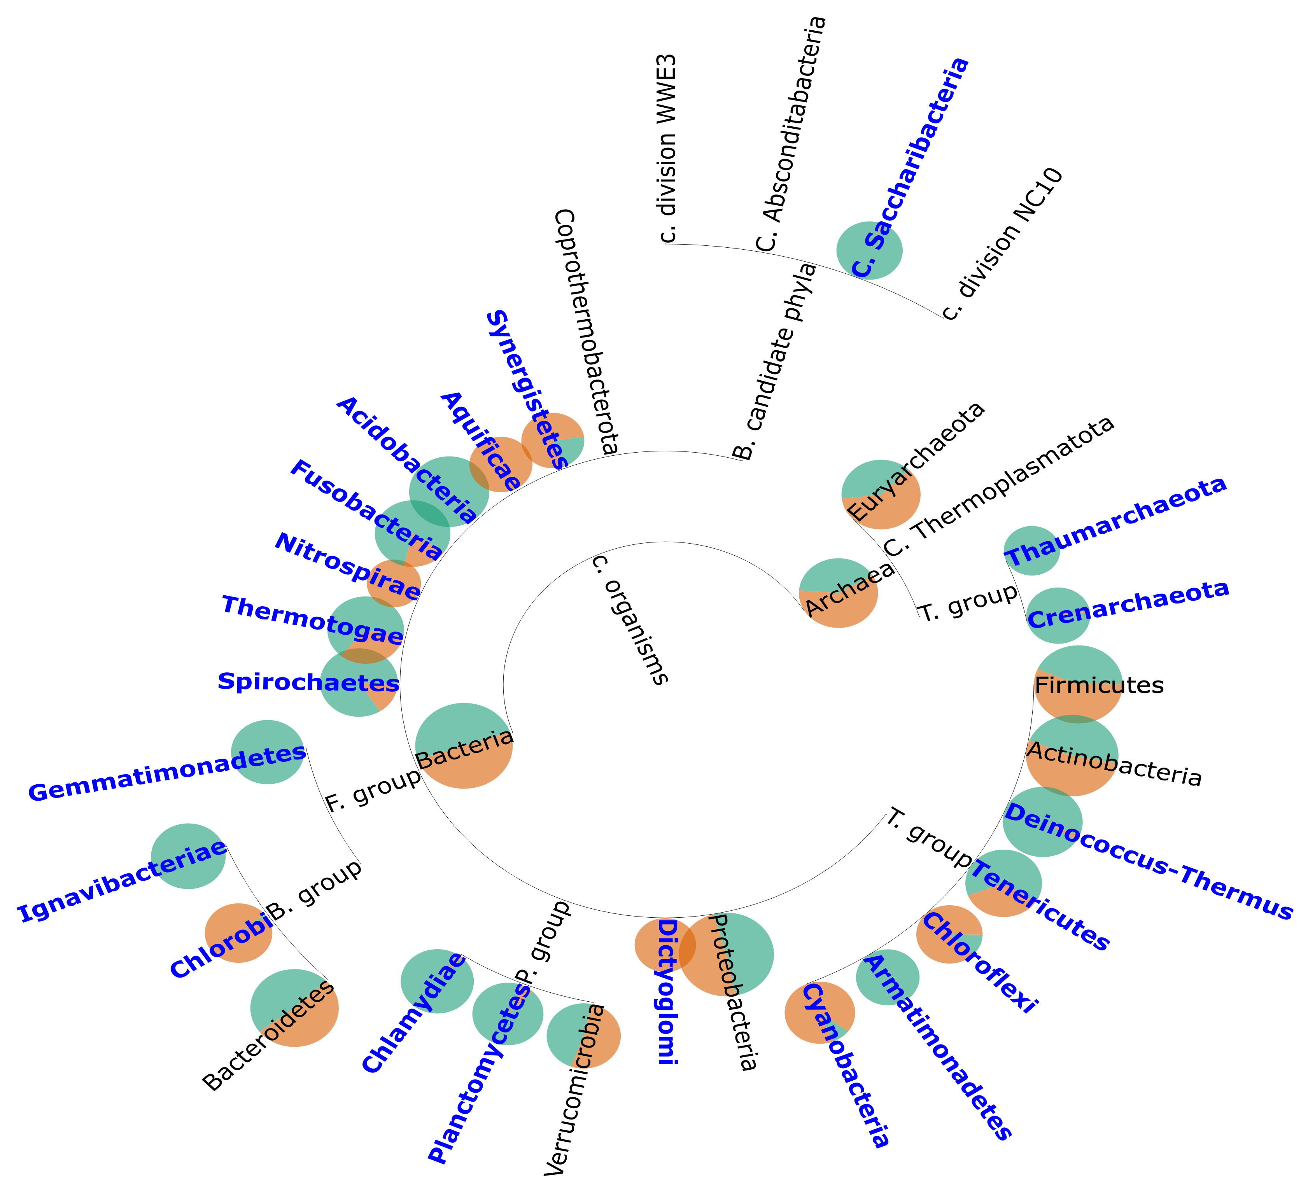
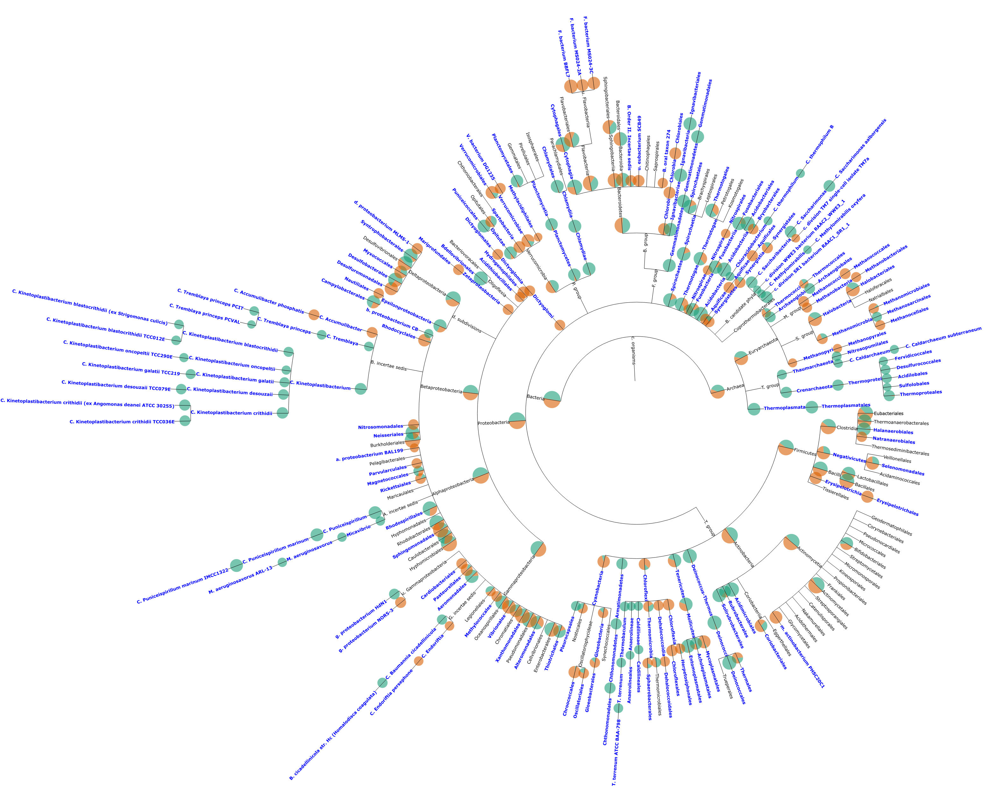
a) Phylum
b) Class
c) Order

Slide 2
(a) Normal Mode
(b) Contrast Mode

Slide 3
(a) Normal Mode
(b) Contrast Mode

